Slide 1
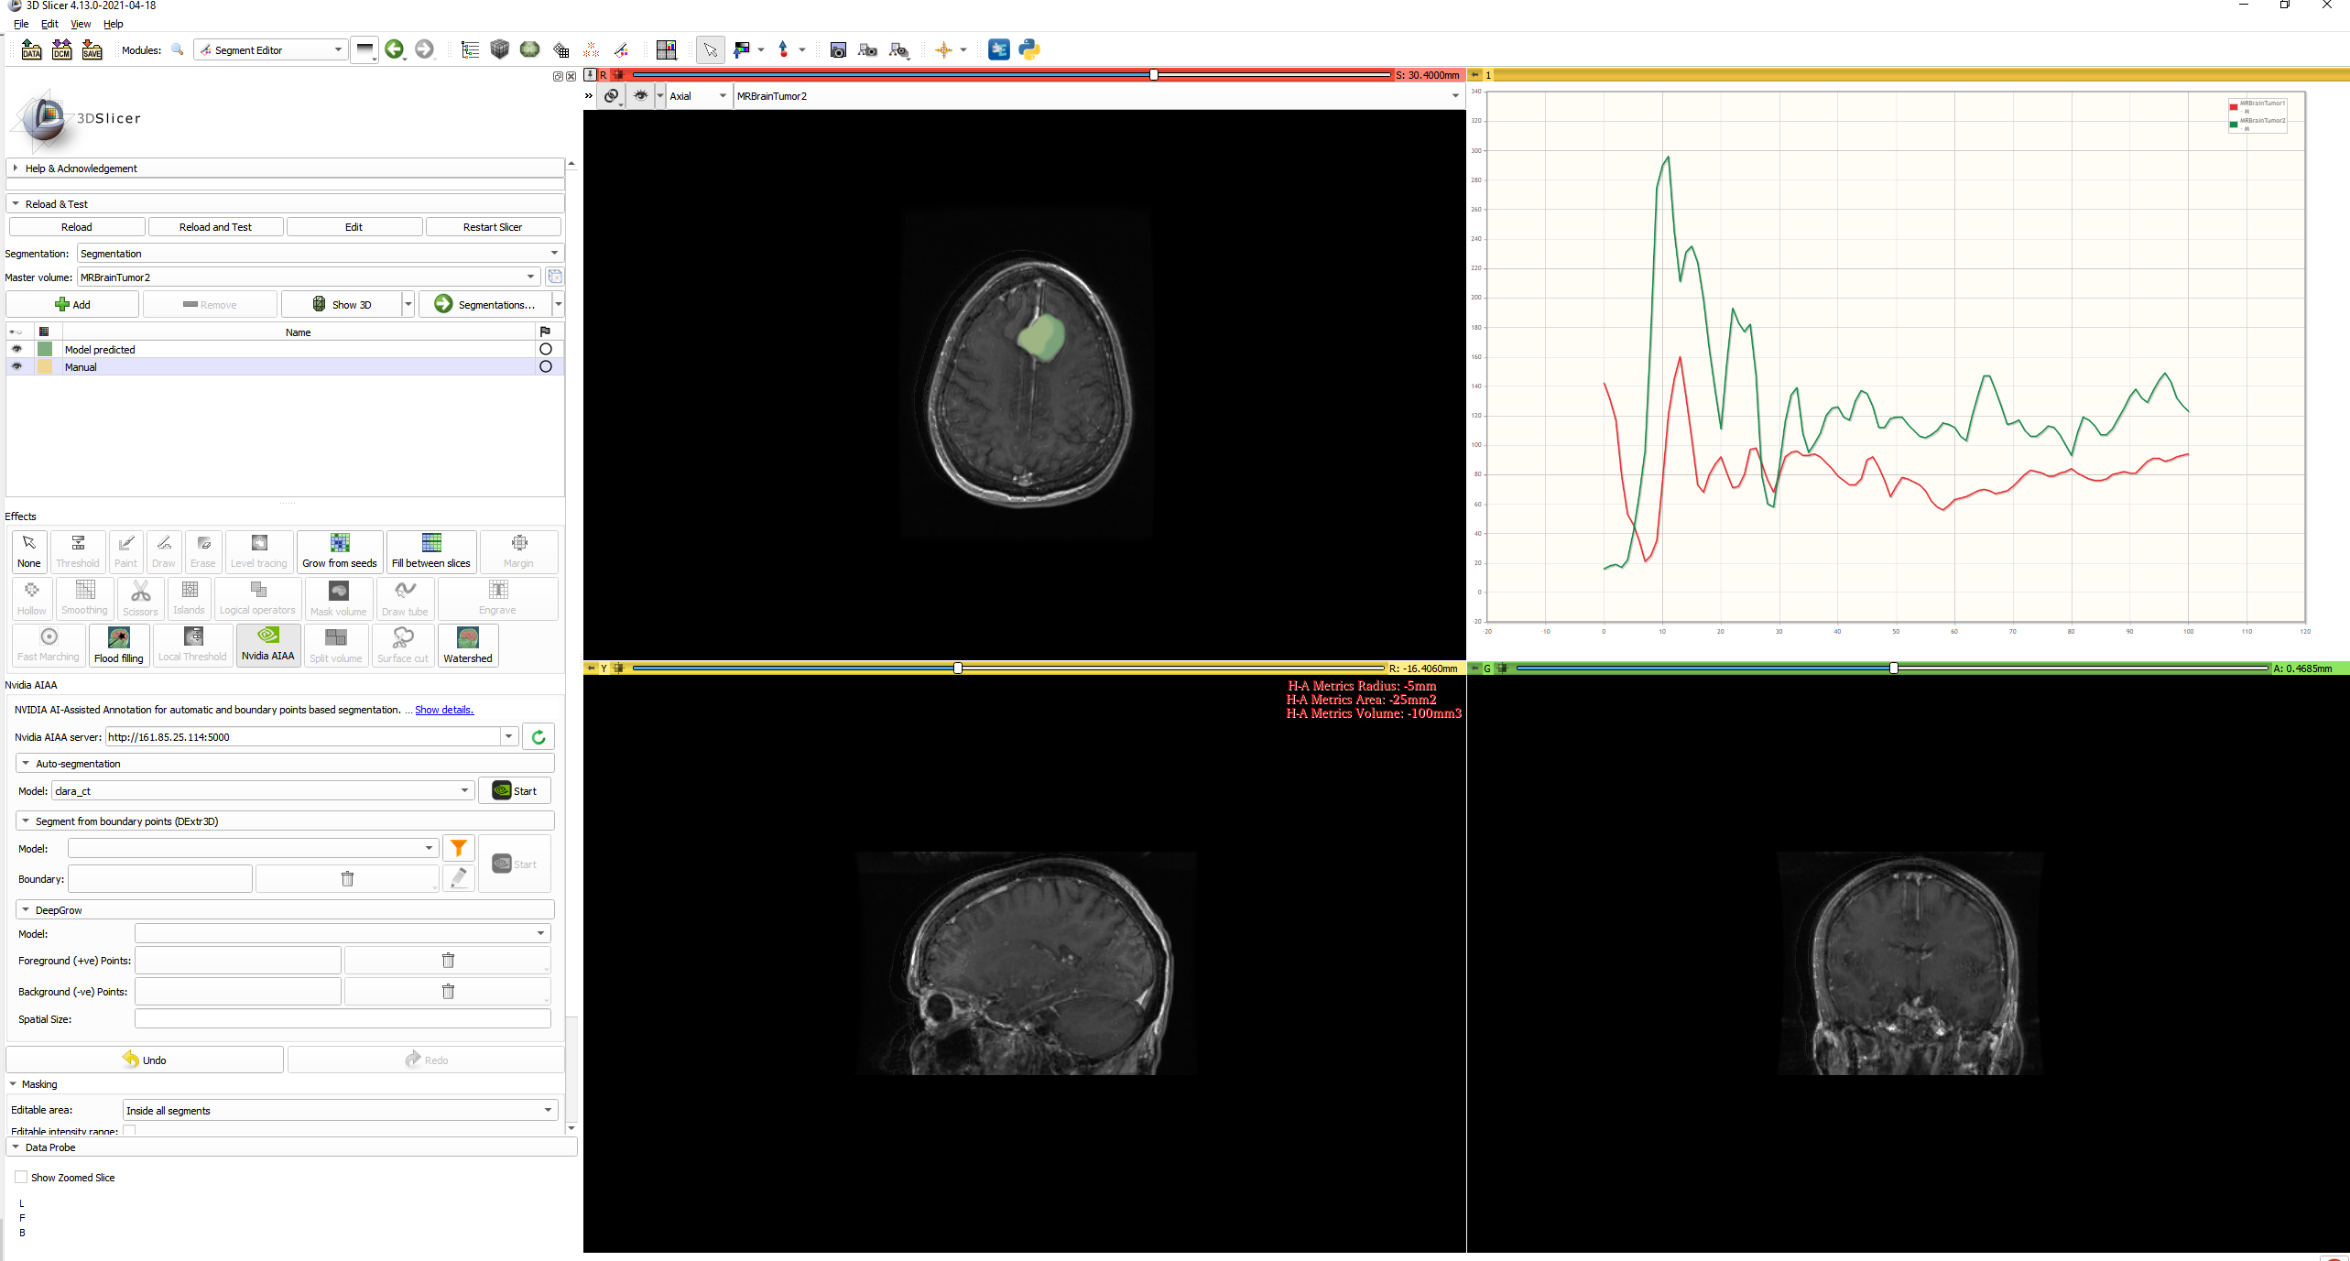
Radiologist add a new segmentation or update the AI model prediction (he does it manually (yellowish color) because he is not satisfied with AI model results - segmentation is not as expected (green color). Different error metrics are calculated (between model output and manual segmentation) and shown on the shadow model viewer (in this case 3D Slicer with custom plugin). Multiple Volume Display (in multiple slicer windows) on live data from different hospitals can be seen. This helps in Identifying the failure cases and store metadata about the failures to later collect only these "tail quality" cases

